Slide 1
Customer services representative training program
Customer services representative training program
Name
Institutional affiliation
Date

Slide 2
Introduction
The customer’s service representative training program is the project that I am waiting to begin.
There are different training methods of training customers service representatives

Slide 3
Training methods in customer service representative training program
Lecture method
Demonstration method
Debriefing method
Discussion method

Slide 4
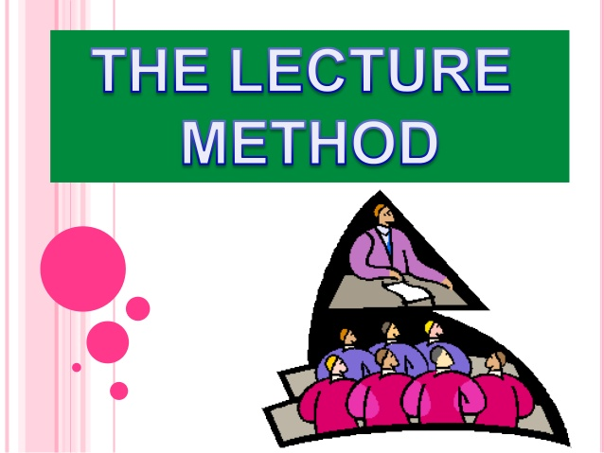
Lecture method
The method is used where participants are more
The technique is the best because all the trainees will be addressed at once and in so doing, the trainers will convey information and expose the learners to the full range of information. (Nayahangan et al., 2018)

Slide 5
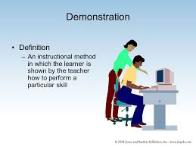
Demonstration method
It involves illustrations and examples.
Participants are guided on what to do.
It makes use of experiment
It helps in memory retention
Raises the interest of the participants

Slide 6
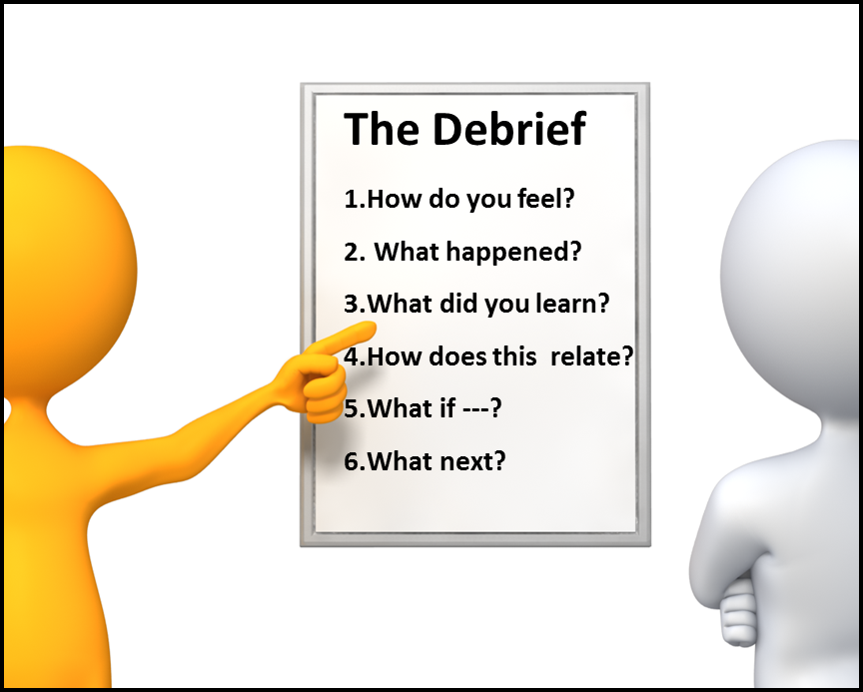
Debrief method
It’s the possible techniques of sharing ideas
It the way in which instructor gets feedback from the trainees
Best way of judging experiences
Possible to know how the participant feels

Slide 7

Discussion method
Involves trainee sharing ideas among themselves
Trainees sharing ideas with trainers
It is done democratically through freedom to express ones view
Instill confidence in training the customer service representatives (Petyaeva et al., 2018).
Discussion method

Slide 8
References
.
Nayahangan, L. J., Stefanidis, D., Kern, D. E., & Konge, L. (2018). How to identify and prioritize procedures suitable for simulation-based training: Experiences from general needs assessments using a modified Delphi method and a needs assessment formula. Medical teacher, 1-8.
Petyaeva, A., Kajander, M., Lawrence, V., Clifton, L., Thomas, A. J., Ballard, C., ... & Nunez, K. M. (2018). Feasibility of a staff training and support programme to improve pain assessment and management in people with dementia living in care homes. International journal of geriatric psychiatry, 33(1), 221-231.

